Slide 1
Convolutional Neural Networks

Slide 2
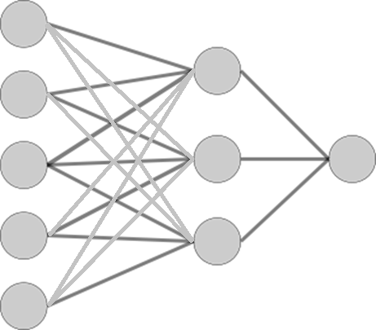
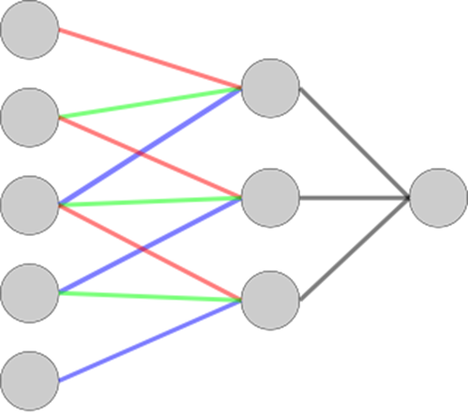
Convolutional Neural Networks
Reduction of Model Complexity
Partially connected & shared weights
Convolutional Neural Network (CNN)
Specialized to sequential data
Images, Speech, Text

Slide 3
Image Classification
X, O Classification
Classifier
X or O
A two-dimensional
array of pixels

Slide 4
Image Classification
translation
Classifier
X
scaling
rotation
weight
Classifier
O

Slide 5
Image Classification
Same?
How to determine both are the same?
=

Slide 6
Image Classification
Both are partially matching
Critical LOCAL features are the same
=
=
=

Slide 7
Image Classification
Local Features
How about finding local features, and
Matching them

Slide 8

Feature Extraction
Convolution
A way to find out local features
1 | 0 | 1
0 | 1 | 1
1 | 1 | 0
1 | 0 | 1
0 | 1 | 0
1 | 0 | 1
*
= 3
$$I∗K=\sum{K_{ij}×I_{ij}}$$

Slide 9
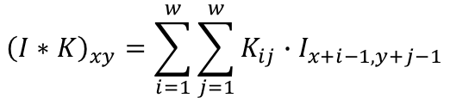
Feature Extraction
Convolution
-1 | -1 | 1
-1 | 1 | -1
1 | -1 | -1
$${\left(I∗K\right)}_{xy}=\sum_{i=1}^{w}{\sum_{j=1}^{w}{K_{ij}∙I_{x+i−1,y+j−1}}}$$
0 | 0 | 0 | 0 | 0 | 0 | 0 | 0
0 | 0 | 0 | 1 | 1 | 0 | 0 | 0
0 | 0 | 1 | 0 | 1 | 1 | 0 | 0
0 | 1 | 0 | 0 | 0 | 0 | 1 | 0
0 | 1 | 0 | 0 | 0 | 0 | 1 | 0
0 | 0 | 1 | 0 | 1 | 1 | 0 | 0
0 | 0 | 0 | 1 | 1 | 0 | 0 | 0
0 | 0 | 0 | 0 | 0 | 0 | 0 | 0
 | -1

Slide 10
Feature Extraction
Convolution
-1 | -1 | 1
-1 | 1 | -1
1 | -1 | -1
$${\left(I∗K\right)}_{xy}=\sum_{i=1}^{w}{\sum_{j=1}^{w}{K_{ij}∙I_{x+i−1,y+j−1}}}$$
0 | 0 | 0 | 0 | 0 | 0 | 0 | 0
0 | 0 | 0 | 1 | 1 | 0 | 0 | 0
0 | 0 | 1 | 0 | 1 | 1 | 0 | 0
0 | 1 | 0 | 0 | 0 | 0 | 1 | 0
0 | 1 | 0 | 0 | 0 | 0 | 1 | 0
0 | 0 | 1 | 0 | 1 | 1 | 0 | 0
0 | 0 | 0 | 1 | 1 | 0 | 0 | 0
0 | 0 | 0 | 0 | 0 | 0 | 0 | 0
 | -1
 | -2

Slide 11
Feature Extraction
Convolution
-1 | -1 | 1
-1 | 1 | -1
1 | -1 | -1
$${\left(I∗K\right)}_{xy}=\sum_{i=1}^{w}{\sum_{j=1}^{w}{K_{ij}∙I_{x+i−1,y+j−1}}}$$
0 | 0 | 0 | 0 | 0 | 0 | 0 | 0
0 | 0 | 0 | 1 | 1 | 0 | 0 | 0
0 | 0 | 1 | 0 | 1 | 1 | 0 | 0
0 | 1 | 0 | 0 | 0 | 0 | 1 | 0
0 | 1 | 0 | 0 | 0 | 0 | 1 | 0
0 | 0 | 1 | 0 | 1 | 1 | 0 | 0
0 | 0 | 0 | 1 | 1 | 0 | 0 | 0
0 | 0 | 0 | 0 | 0 | 0 | 0 | 0
 | -1
 | -2
 | 1

Slide 12
Feature Extraction
Convolution
-1 | -1 | 1
-1 | 1 | -1
1 | -1 | -1
$${\left(I∗K\right)}_{xy}=\sum_{i=1}^{w}{\sum_{j=1}^{w}{K_{ij}∙I_{x+i−1,y+j−1}}}$$
0 | 0 | 0 | 0 | 0 | 0 | 0 | 0
0 | 0 | 0 | 1 | 1 | 0 | 0 | 0
0 | 0 | 1 | 0 | 1 | 1 | 0 | 0
0 | 1 | 0 | 0 | 0 | 0 | 1 | 0
0 | 1 | 0 | 0 | 0 | 0 | 1 | 0
0 | 0 | 1 | 0 | 1 | 1 | 0 | 0
0 | 0 | 0 | 1 | 1 | 0 | 0 | 0
0 | 0 | 0 | 0 | 0 | 0 | 0 | 0
 | -1 | -2 | 0 | -2 | -1 | 1
 | -2 | 3 | -2 | -2 | -2 | -2
 | 1 | -1 | -2 | 0 | -4 | -1
 | -1 | -3 | 0 | -2 | 0 | 1
 | -2 | -1 | -4 | 0 | 2 | -2
 | 1 | -2 | 0 | 0 | -3 | -1

Slide 13
Feature Extraction
Convolution
-1 | -1 | 1
-1 | 1 | -1
1 | -1 | -1
$${\left(I∗K\right)}_{xy}=\sum_{i=1}^{w}{\sum_{j=1}^{w}{K_{ij}∙I_{x+i−1,y+j−1}}}$$
0 | 0 | 0 | 0 | 0 | 0 | 0 | 0
0 | 0 | 0 | 1 | 1 | 0 | 0 | 0
0 | 0 | 1 | 0 | 1 | 1 | 0 | 0
0 | 1 | 0 | 0 | 0 | 0 | 1 | 0
0 | 1 | 0 | 0 | 0 | 0 | 1 | 0
0 | 0 | 1 | 0 | 1 | 1 | 0 | 0
0 | 0 | 0 | 1 | 1 | 0 | 0 | 0
0 | 0 | 0 | 0 | 0 | 0 | 0 | 0
0 | 0 | -1 | -2 | 0 | 1 | 0 | 0
0 | -1 | -2 | 0 | -2 | -1 | 1 | 0
-1 | -2 | 3 | -2 | -2 | -2 | -2 | 1
-2 | 1 | -1 | -2 | 0 | -4 | -1 | 0
0 | -1 | -3 | 0 | -2 | 0 | 1 | -2
1 | -2 | -1 | -4 | 0 | 2 | -2 | -1
0 | 1 | -2 | 0 | 0 | -3 | -1 | 0
0 | 0 | 1 | 0 | -2 | -1 | 0 | 0

Slide 14
Feature Extraction
Threshold
-1 | -1 | 1
-1 | 1 | -1
1 | -1 | -1
$${\left(I∗K\right)}_{xy}=\sum_{i=1}^{w}{\sum_{j=1}^{w}{K_{ij}∙I_{x+i−1,y+j−1}}}$$
0 | 0 | 0 | 0 | 0 | 0 | 0 | 0
0 | 0 | 0 | 1 | 1 | 0 | 0 | 0
0 | 0 | 1 | 0 | 1 | 1 | 0 | 0
0 | 1 | 0 | 0 | 0 | 0 | 1 | 0
0 | 1 | 0 | 0 | 0 | 0 | 1 | 0
0 | 0 | 1 | 0 | 1 | 1 | 0 | 0
0 | 0 | 0 | 1 | 1 | 0 | 0 | 0
0 | 0 | 0 | 0 | 0 | 0 | 0 | 0
0 | 0 | 0 | 0 | 0 | 1 | 0 | 0
0 | 0 | 0 | 0 | 0 | 0 | 1 | 0
0 | 0 | 3 | 0 | 0 | 0 | 0 | 1
0 | 1 | 0 | 0 | 0 | 0 | 0 | 0
0 | 0 | 0 | 0 | 0 | 0 | 1 | 0
1 | 0 | 0 | 0 | 0 | 2 | 0 | 0
0 | 1 | 0 | 0 | 0 | 0 | 0 | 0
0 | 0 | 1 | 0 | 0 | 0 | 0 | 0

Slide 15
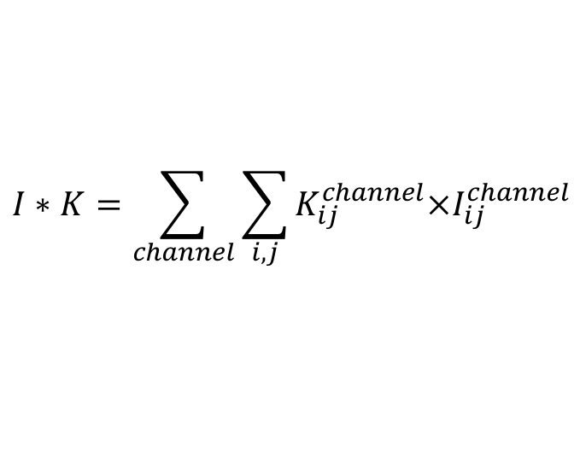
Feature Extraction
Convolution (3D)
0 | 0 | 1
0 | 1 | 0
1 | 0 | 0
-1 | -1 | 1
-1 | 1 | 0
1 | 0 | 0
0 | 0 | 1
0 | 1 | 0
1 | 0 | 0
-1 | -1 | 1
-1 | 1 | 0
1 | 0 | 0
1 | 0 | 1
0 | 0 | 0
1 | 0 | 0
1 | -1 | 1
-1 | 1 | -1
1 | -1 | -1
*
= 2 +3 +4 = 9
$$I∗K=\sum_{channel}{\sum_{i,j}{K_{ij}^{channel}×I_{ij}^{channel}}}$$

Slide 16





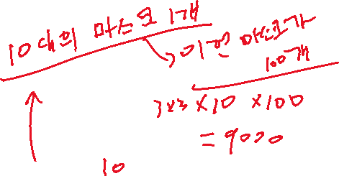

Feature Extraction
Convolution (3D)
-1 | -1 | 1
-1 | 1 | 0
1 | 0 | 0
-1 | -1 | 1
-1 | 1 | 0
1 | 0 | 0
-1 | -1 | 1
-1 | 1 | -1
1 | -1 | -1
0 | 1 | 1 | 0 | 0 | 1
0 | 1 | 1 | 1 | 1 | 0
1 | 1 | 0 | 0 | 1 | 1
1 | 1 | 0 | 0 | 1 | 1
0 | 1 | 1 | 1 | 1 | 0
1 | 0 | 1 | 1 | 0 | 0
0 | 0 | 0 | 1 | 1 | 1
0 | 1 | 1 | 1 | 1 | 0
1 | 1 | 0 | 0 | 1 | 1
1 | 1 | 0 | 0 | 1 | 1
1 | 1 | 1 | 1 | 1 | 0
0 | 0 | 1 | 1 | 0 | 0
-1 | 2 | 4 | -2 | -1 | -4
0 | 2 | 5 | 1 | 3 | 2
-2 | 0 | 4 | 2 | -6 | 1
-2 | 1 | 0 | -2 | 3 | -3
1 | 2 | -4 | 4 | 2 | -2
1 | -2 | -4 | 3 | 2 | 1
0 | 0 | 1 | 1 | 0 | 0
0 | 1 | 1 | 1 | 1 | 0
1 | 1 | 0 | 0 | 1 | 1
1 | 1 | 0 | 0 | 1 | 1
0 | 1 | 1 | 1 | 1 | 0
0 | 0 | 1 | 1 | 0 | 0

Slide 17
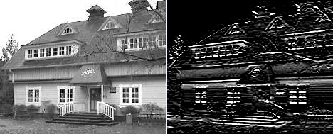
Feature Extraction
Examples of Kernels
1 | 1 | 1
0 | 0 | 0
-1 | -1 | -1
Horizontal Line

Slide 18
Feature Extraction
Pooling
Subsampling from m by m pixels into 1 pixels
Max, averaging or L^{p} pooling
0 | 0 | 0 | 0 | 0 | 1 | 0 | 0
0 | 0 | 0 | 0 | 0 | 0 | 1 | 0
0 | 0 | 3 | 0 | 0 | 0 | 0 | 1
0 | 1 | 0 | 0 | 0 | 0 | 0 | 0
0 | 0 | 0 | 0 | 0 | 0 | 1 | 0
1 | 0 | 0 | 0 | 0 | 2 | 0 | 0
0 | 1 | 0 | 0 | 0 | 0 | 0 | 0
0 | 0 | 1 | 0 | 0 | 0 | 0 | 0
0 | 0 | 1 | 1
1 | 3 | 0 | 1
1 | 0 | 2 | 1
1 | 1 | 0 | 0
Subsampled
feature map
Feature map

Slide 19
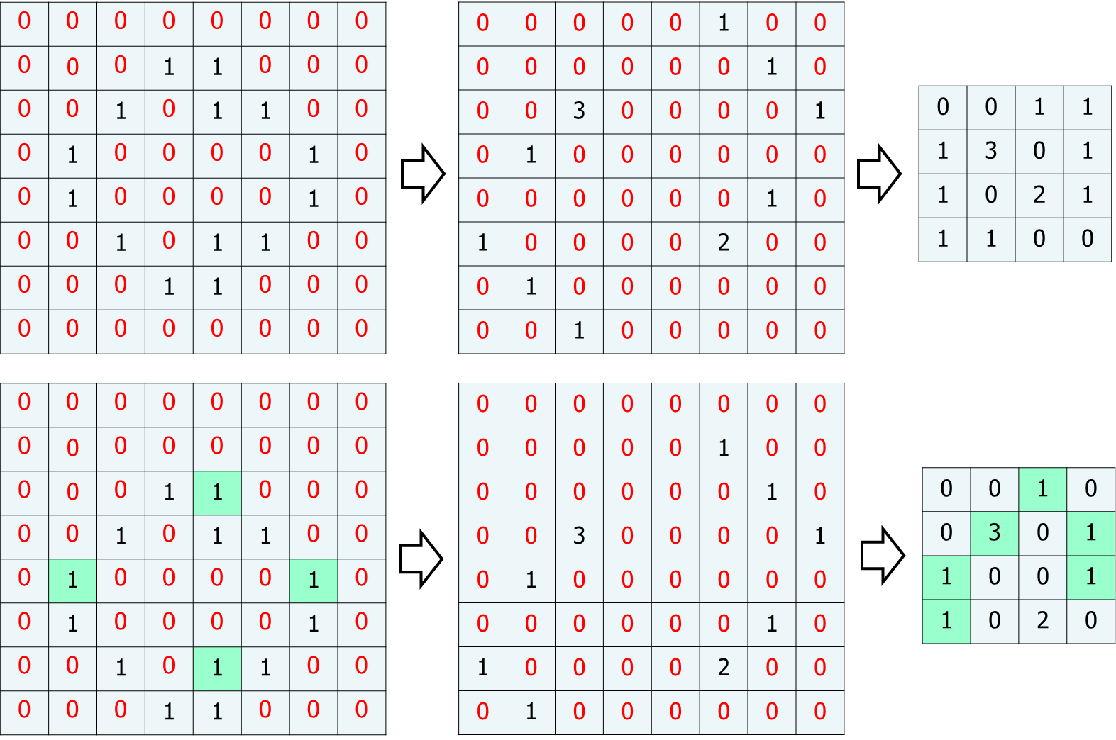
Feature Extraction
Advantage of Pooling
Reducing the number of parameters
Generating more robust feature maps: Shift Invariant
Original
Image
More non-zero values are matched !!
Shifted
Image

Slide 20
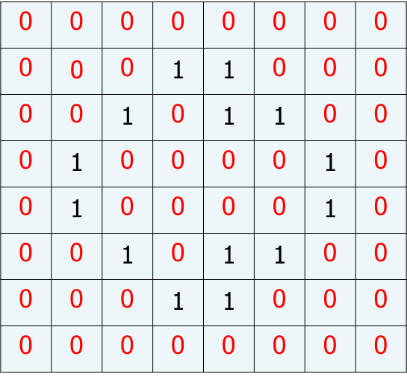
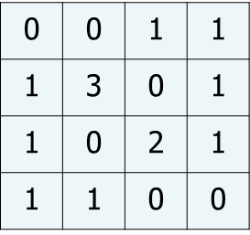
Convolutional Neural Networks
Feature Extraction
Convolution
Threshold
Sub-sampling
Image
Feature map

Slide 21
Convolutional Neural Networks
Feature map is also an image
We can extract many different feature maps
If we can cascade this step many times, we can have a higher feature map
Convolution
Threshold
Sub-sampling
Image
Feature map

Slide 22
Convolutional Neural Networks
Structure
Feature
Map 1
Image
Feature
Map 2
Feature
Map 3

Slide 23
Convolutional Neural Networks
Structure
Higher
Feature
Map 1
Feature
Map 1
Higher
Feature
Map 2
Image
Feature
Map 2
Feature
Map n
Higher
Feature
Map m

Slide 24
Convolutional Neural Networks
Structure
Feature
Map 1
Feature
Map 2
Image
Feature
Map n
Convolution
&
Threshold
Pooling
Convolution
&
Threshold
Pooling
Fully Connected
Layers

Slide 25
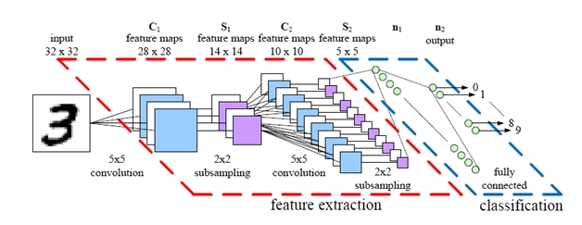
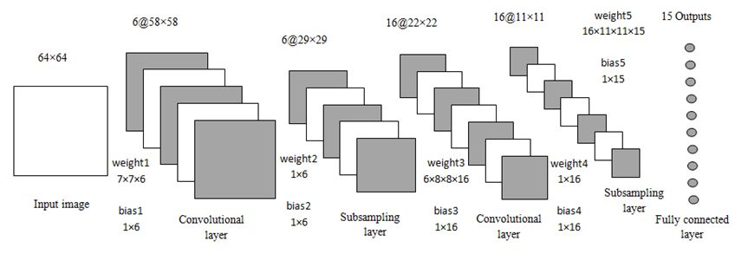
Convolutional Neural Networks
Various Graphical Representation

Slide 26
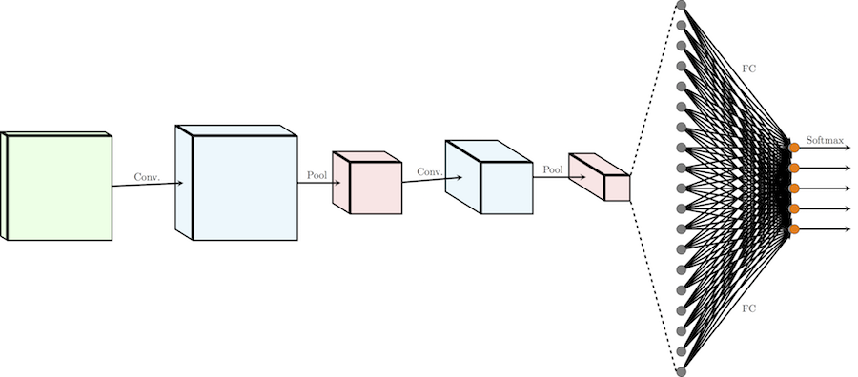
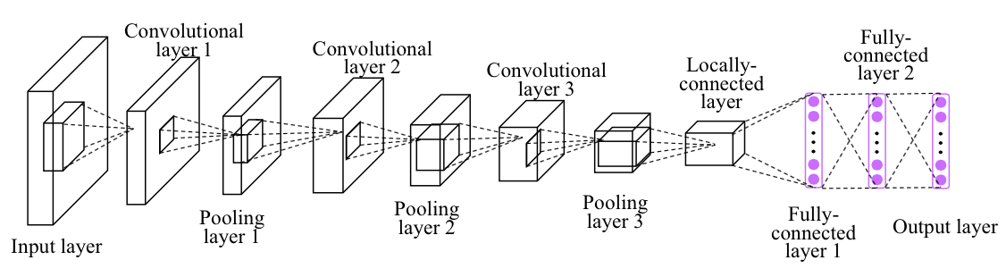
Convolutional Neural Networks
Various Graphical Representation

Slide 27
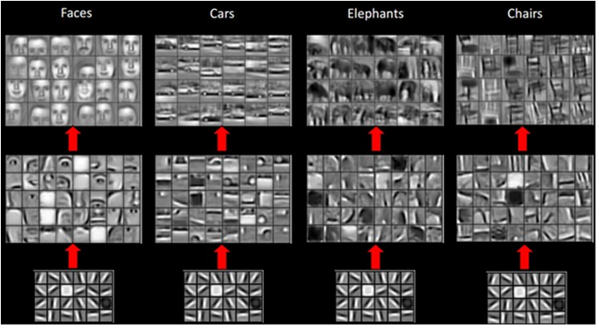
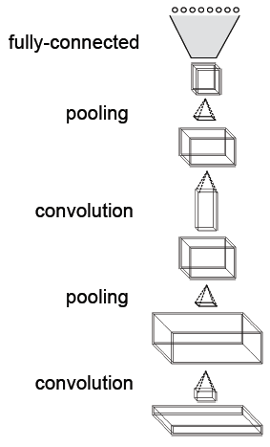
Convolutional Neural Networks
Example

